Slide 1

Python Study
Environ. Analysts
<환경을 분석할 줄 아는 사람이 되자!>

Slide 2

Python Study
<환경을 분석할 줄 아는 사람이 되자!>
Contents
1. Stacking Block in Deep Learning
2. Transfer Learning & Fine Tuning

Slide 3
Python Study
<환경을 분석할 줄 아는 사람이 되자!>
1. Stacking Block in Deep Learning
Summary of Total Processes of Machine Learning
Deep learning is one of Machine Learning methods, which means it also follow the similar route for making the optimization models.
4 Big steps is widely used to explain the machine learning process
Selection of Variables for Inputs(X) and Outputs(Y)
Preprocessing or Pretreatment of Data, making data proper form
Data Generation & Modification
Which machine learning methods will be used?
(i.e. Linear Regression/SVM/Random Forest/ Ensemble/ Deep Learning etc.)
Model Construction
Fitting models to be optimized.
Utilizing a part of the input data, calculating the model accuracy, loss
Training & Evaluation Loop
Utilizing the optimized model, X_true is changed to Y_predict. Knowing the difference between Y_true and Y_predict
Prediction
But, trials and errors are necessary for complete models.

Slide 4
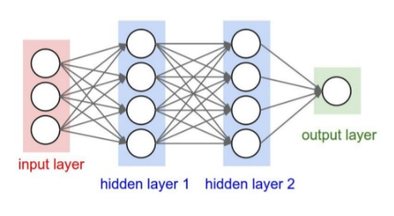
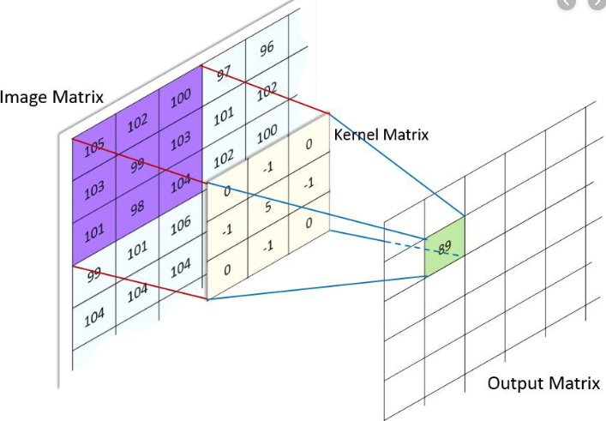
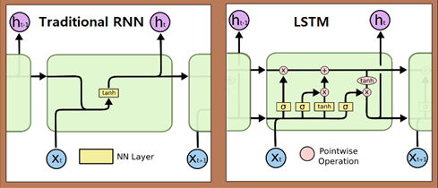
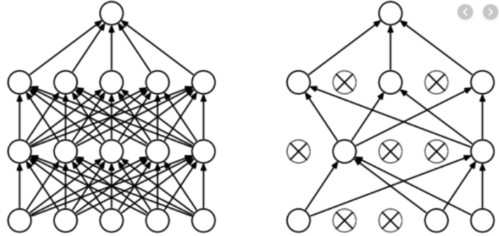
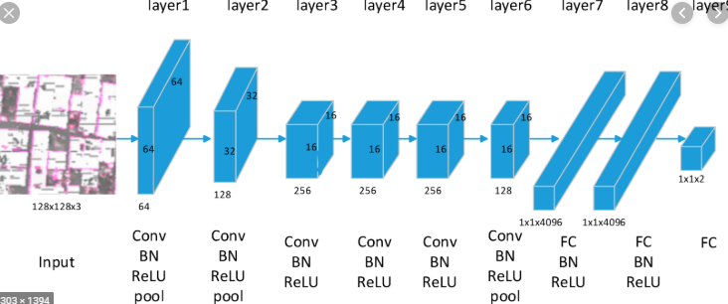
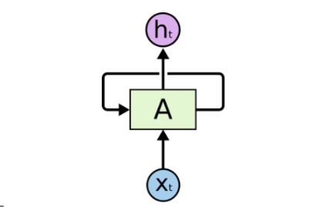
Python Study
<환경을 분석할 줄 아는 사람이 되자!>
1. Stacking Block in Deep Learning
The Basic Model Structure
Fully Connected layer(FC) or
Dense layer
Convolutional Neural Network(CNN)
Recurrent Neural Network(RNN)
There are so many model structures(i.e. GAN, LSTM, GRU, Autoencoder etc.) and we need to make them proper to the inputs

Slide 5
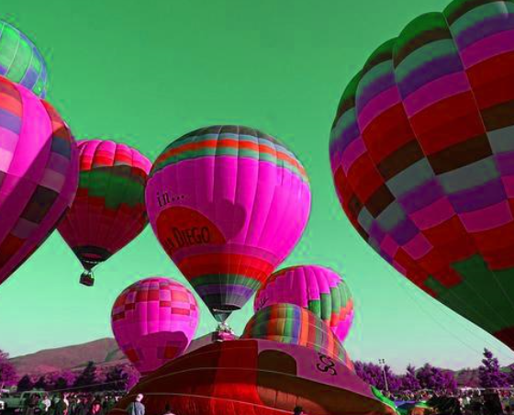
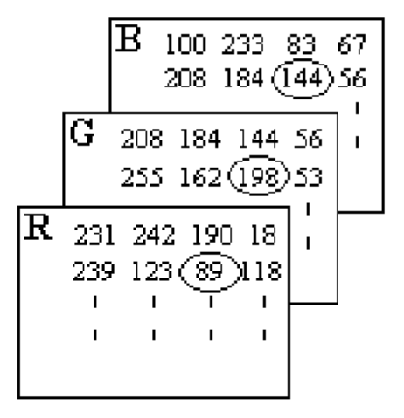
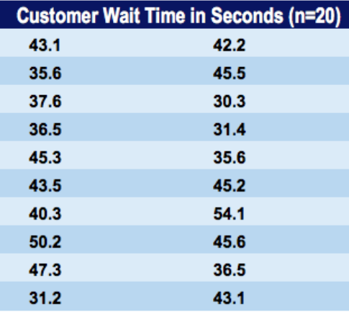
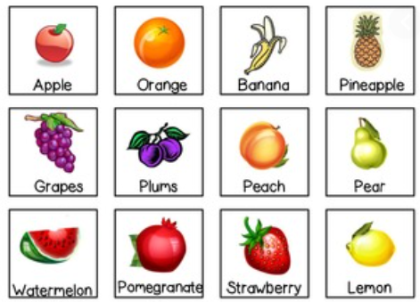
Python Study
<환경을 분석할 줄 아는 사람이 되자!>
1. Stacking Blocks in Deep Learning
Among the Big 4 steps, this part deals with the construction of model structure of deep learning.
The structure of deep learning is undefined before we made its structure.
So, we need to ‘Build the model which seems to be proper at the first time’
Inputs
Model
What is the optimal determination of the model structure?
Dense Layer(NN)
CNN, ResNet
<Image>
RNN, LSTM
Nobody knows the perfect structure in the first time without trials and errors
<Number>
Autoencoder
GAN
<Category>

Slide 6
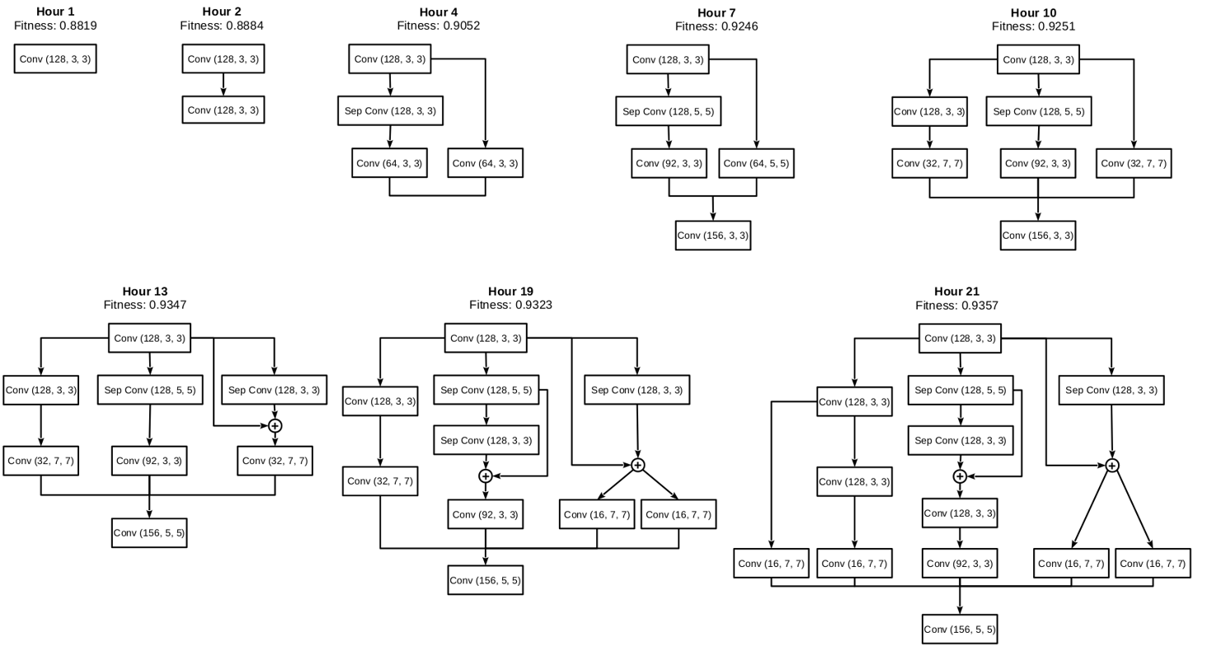
Python Study
<환경을 분석할 줄 아는 사람이 되자!>
1. Stacking Blocks in Deep Learning
Different Model Structures
<https://www.ibm.com/blogs/research/wp-content/uploads/2018/08/NewFigure3MartinWistuba.png>

Slide 7
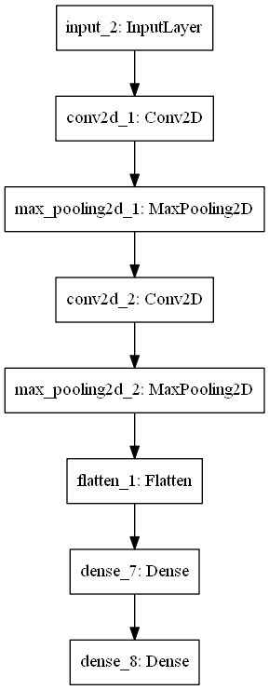
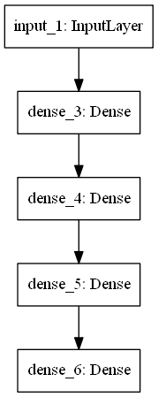

Python Study
<환경을 분석할 줄 아는 사람이 되자!>
1. Stacking Blocks in Deep Learning
There are two versions to stack blocks in deep learning model structure in Keras, ‘Sequential Models’ and ‘Functional Models.
In Sequential Models, we can more easily construct model structure in the simplest way. However, it can only make literally sequential model but cannot make complex structure of models.
So Functional Models are used to make models in the purpose of model structure customization.
Sequential Models in Keras
CNN
NN
NN

Slide 8
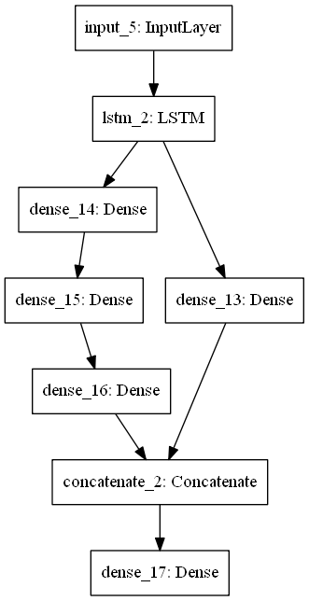
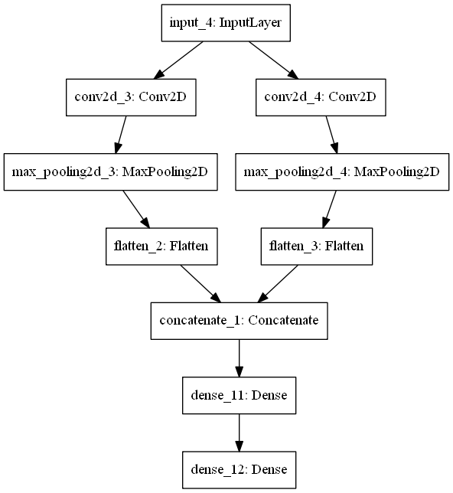
Python Study
<환경을 분석할 줄 아는 사람이 되자!>
1. Stacking Blocks in Deep Learning
Functional Models in Keras

Slide 9
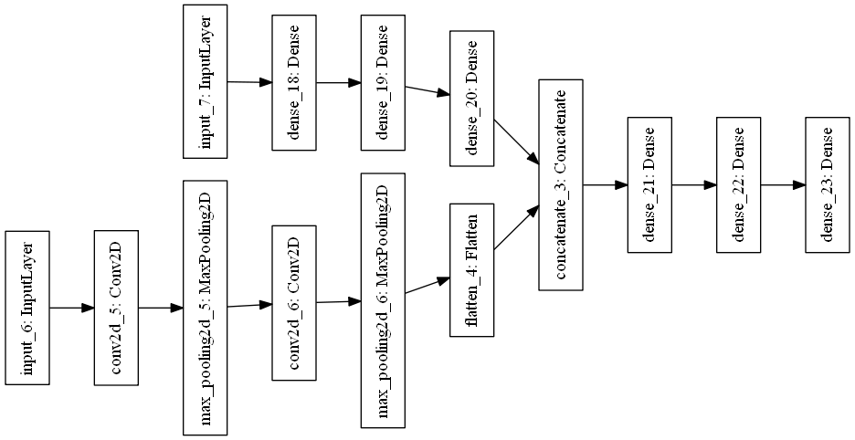

Python Study
<환경을 분석할 줄 아는 사람이 되자!>
1. Stacking Blocks in Deep Learning
This structure is essential when applying for multiple form data(i.e. numeric with image, image with categories)
And most of models solving complex problems use considerably deep and complex structures.
In my project, the type of input data will be ‘image and numeric’
NN
Temperature
Humidity
PM2.5, PM10
….
NN
0.813
<Number>
Probability of Precipitatioin
<Image>
CNN

Slide 10
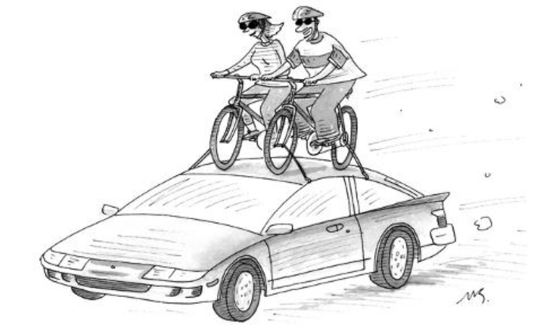
Python Study
<환경을 분석할 줄 아는 사람이 되자!>
2. Transfer Learning & Fine Tuning
Transfer learning is a research problem in machine learning that focuses on storing knowledge gained while solving one problem and applying it to a different but related problem(West, Jeremy et al, 2007)
Easy Concept!
‘New information is based on the past information’
With the small endeavor deserving riding a bike, we can experience much more delight on cars which is already made by someone.
If I have seen further it is by standing on the shoulders of Giants.
-Sir Isaac Newton, 1676-
https://github.com/aditya9898/transfer-learning
https://towardsdatascience.com/a-comprehensive-hands-on-guide-to-transfer-learning-with-real-world-applications-in-deep-learning-212bf3b2f27a
West, Jeremy; Ventura, Dan; Warnick, Sean (2007). "Spring Research Presentation: A Theoretical Foundation for Inductive Transfer". Brigham Young University, College of Physical and Mathematical Sciences. Archived from the original on 2007-08-01. Retrieved 2007-08-05.
Notes:
자전거를 타는 노력밖에 하지 않았지만 나는 누군가 만들어 놓은 차 위에 올라 그 이상의 경험을 즐길 수 있다.

Slide 11
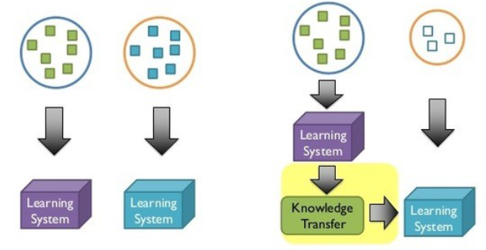
Python Study
<환경을 분석할 줄 아는 사람이 되자!>
2. Transfer Learning & Fine Tuning
Traditional Deep Learning
Transfer Learning
Isolated, single task learning
Learning of a new tasks relies on the previous learned tasks
Faster
Accurate
Less training data
VGG,
GoogleNet,
ResNet. Etc.
https://machinelearningmastery.com/how-to-use-transfer-learning-when-developing-convolutional-neural-network-models/
https://medium.com/@14prakash/transfer-learning-using-keras-d804b2e04ef8

Slide 12
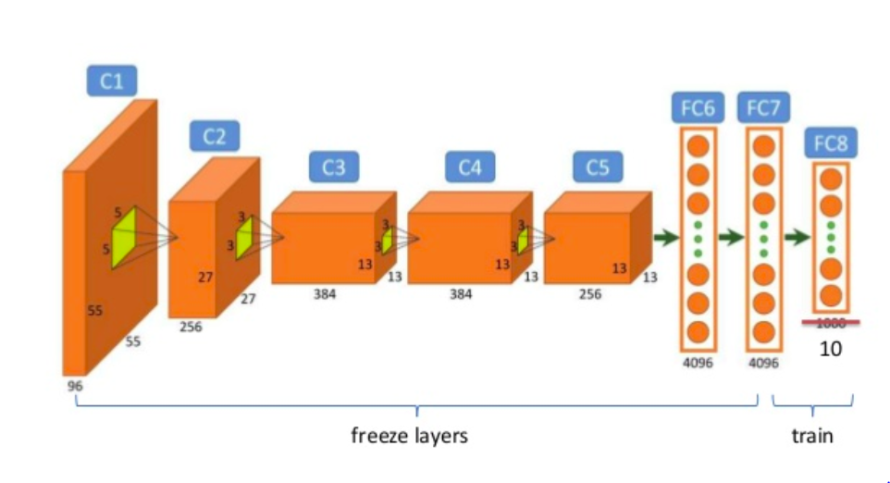
Python Study
<환경을 분석할 줄 아는 사람이 되자!>
2. Transfer Learning & Fine Tuning
Fine Tuning
Fine tuning means taking some machine learning model that has already learned something before and then training that.
It contains the finely change the model weights.
1. Make model structure using Transfer Learning Method.
2. Proper Model(Modify and append new layers.)
3. Warm-up(Freezing original layers, Training new appended layers)
4. Fine Tuning(Unfreezing original layers, Training total model.)
https://flyyufelix.github.io/2016/10/08/fine-tuning-in-keras-part2.html

Slide 13

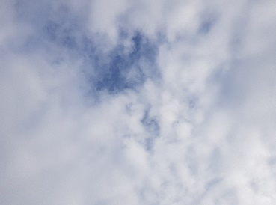
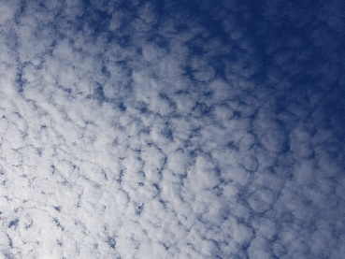
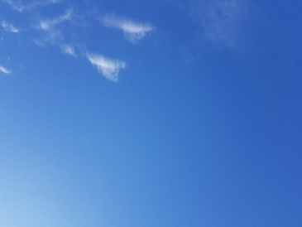
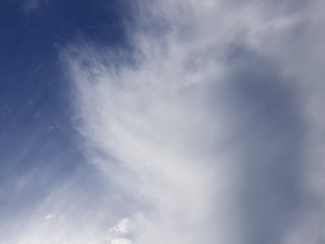
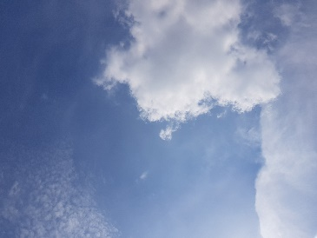

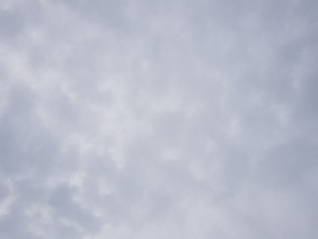
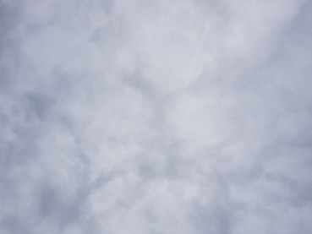
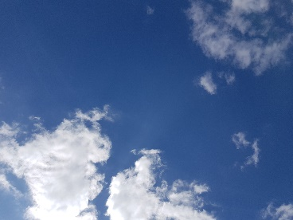
구름 Project
목표 사진 수 1000 중 10장(1%)달성
➔ 데이터 확보 속도가 너무 늦는 상황
현재 5개의 구름 사진 측정망 확보
지스트, 한양대, 서울대, 포스텍, 신림역
조건1, 일자가 달라야 합니다
조건 2, 고정된 장소에서 찍어야 합니다
조건 3, 90도 각도로 렌즈는 깨끗한 상태로
조건 4, 촬영 시간은 9시에서 18시 사이 정시에
70%
30%
0%
0%
0%
20%
20%
20%
20%
20%

